Slide 1
Programming Fundamentals
Course Code: CS-111
Course Instructor: Isra Naz

Slide 2
Multiple if-else-if structure
If-else-if statement can be used to choose one block of statements from many blocks of statement.
It is used when there are many options and only one block of statements should be executed on the basis of a condition

Slide 3
Multiple if-else-if structure
Syntax
if(condition)
{
Statement 1;
}
else if (condition)
{
Statements 2;
}
.
.
.
else
{
Statement N;
}

Slide 4
Example 1
Write a program that inputs test score of a student and displays his grade according to the following criteria
Test Score Grade
>=90 A
80-89 B
70-79 C
60-69 D
Below 60 F

Slide 5
Example 1 (Sol)
{
int marks;
cout<<“Enter marks:”;
cin>>marks;
if(marks>=90)
Cout<<“Grade A”;
else if(marks>=80)
Cout<<“Grade B”;
else if(marks>=70)
Cout<<“Grade C”;
else if(marks>=60)
Cout<<“Grade D”;
else
Cout<<“Grade F”;
}

Slide 6
Compound condition
A type of comparison in which more than one conditions are evaluated is called compound condition
E.g.
A program inputs two numbers. It displays OK if one number is greater than 100 and second number is less than 100.
Logical operators are used to evaluate compound conditions i.e.
AND operator (&&)
OR operator (||)
NOT operator (!)

Slide 7
Example
Program inputs three numbers and displays the maximum number
{
int a,b,c;
cout<<“enter three numbers:”;
cin>>a>>b>>c;
if(a>b && a>c)
cout<<“maximum number is”<<a;
else if (b>a && b>c)
cout<<“maximum number is”<<b;
else
cout<<“maximum number is”<<c;
}

Slide 8
Example
Program that inputs a character and displays whether it is a vowel or not
int main()
{
char ch;
cout<<“enter character”;
cin>>ch;
if(ch==‘a’ || ch ==‘a’ ||ch==‘e’ || ch ==‘e’ ||ch==‘i’ || ch ==‘i’ ||ch==‘o’ || ch ==‘o’ ||ch==‘u’ || ch ==‘u’)
cout<<“you entered a vowel”<<ch;
else
cout<<“you did not enter a vowel”<<ch;
}

Slide 9
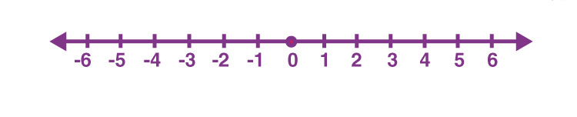
Practice Quiz 10 marks
Write a program to take a number as input from the user and check whether the entered integer number is positive, negative or zero.
Hint: Keep in mind the number line

Slide 10
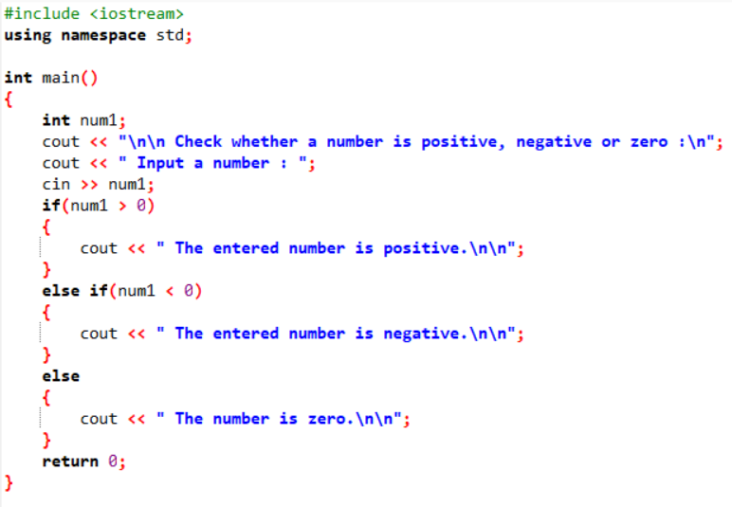
Task
Write a program to take a number as input from the user and check whether the entered integer number is positive, negative or zero.

Slide 11
Nested if-else Statement
if(condition)
else
{
statements(s);
}
Outer if
if(condition)
{
statement(s);
}
else
{
statement(s);
Inner if

Slide 12
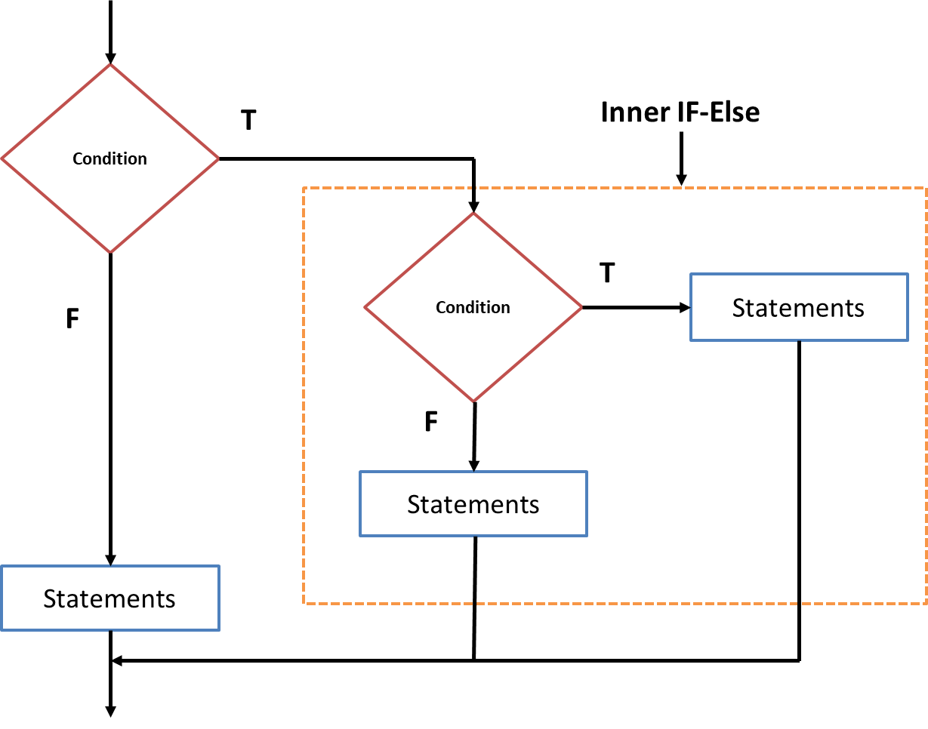
Nested if-else Statement

Slide 13
Example
Program that inputs three numbers and displays the smallest number by using nested if condition.

Slide 14
Example
int main()
{
int a,b,c;
cout<<“enter three numbers”;
cin>>a>>b>>c;
if(a<b)
if(a<c)
cout<<a<<“is smallest number”;
else
cout<<c<<“is smallest number”;
else
if(b<c)
cout<<b<<“is smallest number”;
else
cout<<c<<“is smallest number”;
}

Slide 15
NOT Operator
The symbol used for NOT operator is !
It is used to reverse the result of a condition
It gives TRUE result if the condition is FALSE
It gives FALSE result if the condition is TRUE

Slide 16
Example
Input a number and displays whether it is even or odd using logical operator “!”

Slide 17
Example
Input a number and displays whether it is even or odd using logical operator “!”
int main()
{
int n;
cout<<“enter number”;
cin>>n;
if(!(n%2==0))
cout<<“you entered odd number”;
else
cout<<“you entered even number.”;
}

Slide 18

The C++ compiler always associates an else with the immediately preceding if unless told to do otherwise by the placement of braces ({ and }).
This behavior can lead to what’s referred to as the dangling -else problem.
 if ( x > 5 )
if ( y > 5 )
cout << "x and y are > 5";
else
cout << "x is <= 5";
appears to indicate that if x is greater than 5, the nested if statement determines whether y is also greater than 5.

Slide 19

 The compiler actually interprets the statement as
 if ( x > 5 )
if ( y > 5 )
cout << "x and y are > 5"; else
cout << "x is <= 5";
 To force the nested if…else statement to execute as
intended, use:
 if ( x > 5 )
{ if ( y > 5 )
} cout << "x and y are > 5";
else
cout << "x is <= 5";
 Braces ({}) indicate that the second if statement is in the body of the first if and that the else is associated with the first if.

Slide 20

The conditional operator is an alternative to simple if-else statement.
It consists of ? (question mark) and a : (colon)
Syntax
{condition} ? {expr1} : {expr2}
If condition evaluates to true then value of expr1 is
returned, otherwise value of expr2 is returned.
Note:
expr1 and expr2 can be constant values or arithmetic expressions. Input / output (i.e. cin, cout) statements may also be used.

Slide 21
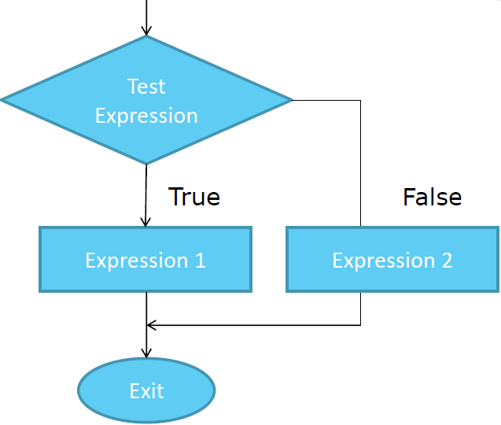

Slide 22
 Example
If a=10 and b=5 and result is an integer variable, then
res = (a>b) ? a : b
The above statement is equivalent to if (a>b)
res=a; else
res=b;

Slide 23


